Slide 1
Team Everest
Closing Ceremony Presentation

Slide 2
Our Team

Slide 3


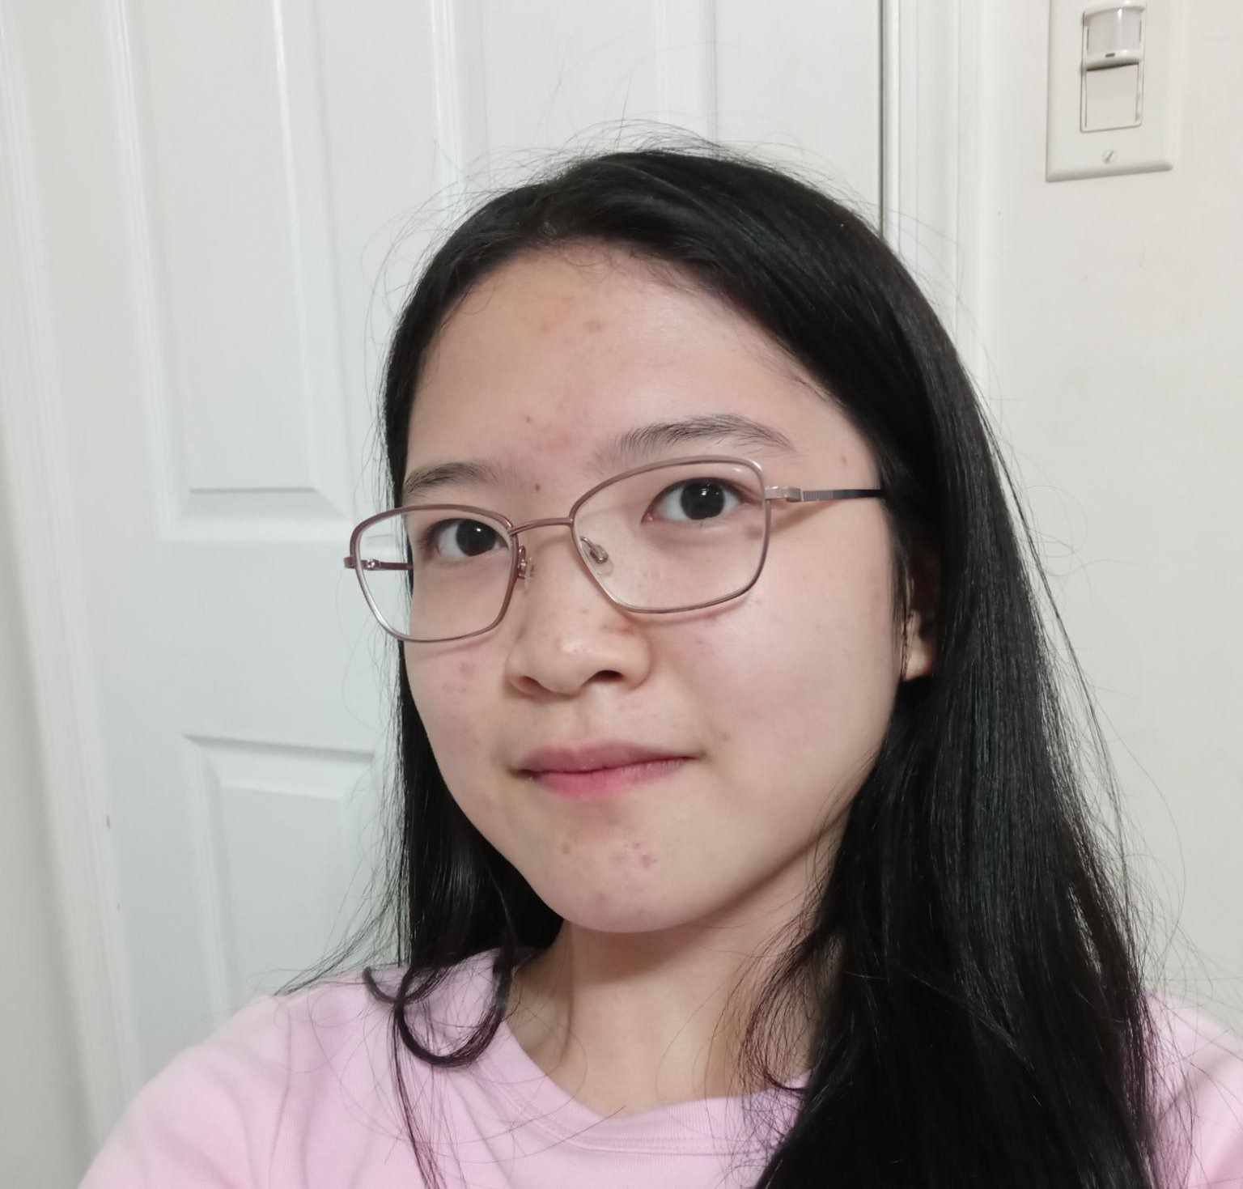
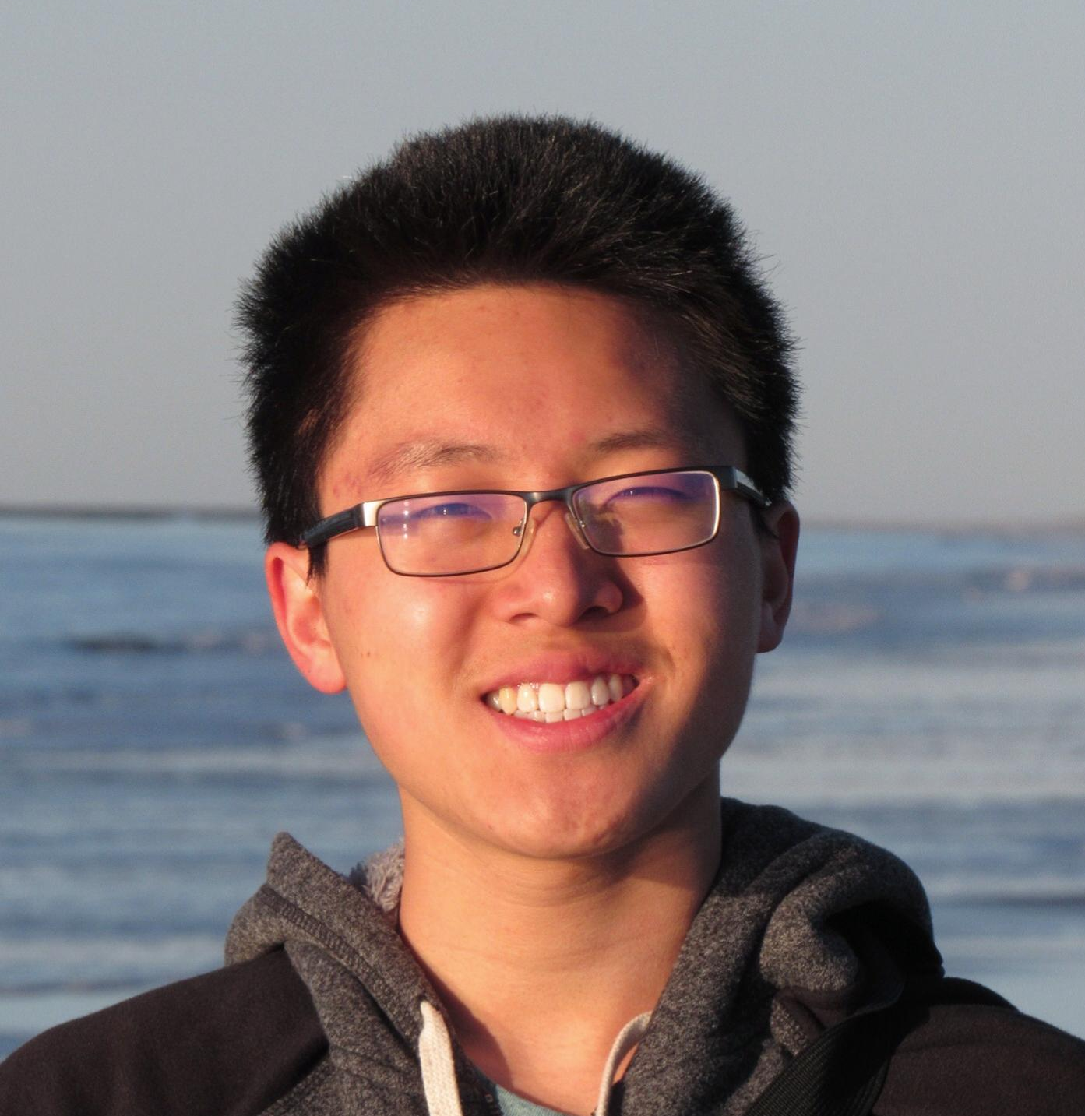


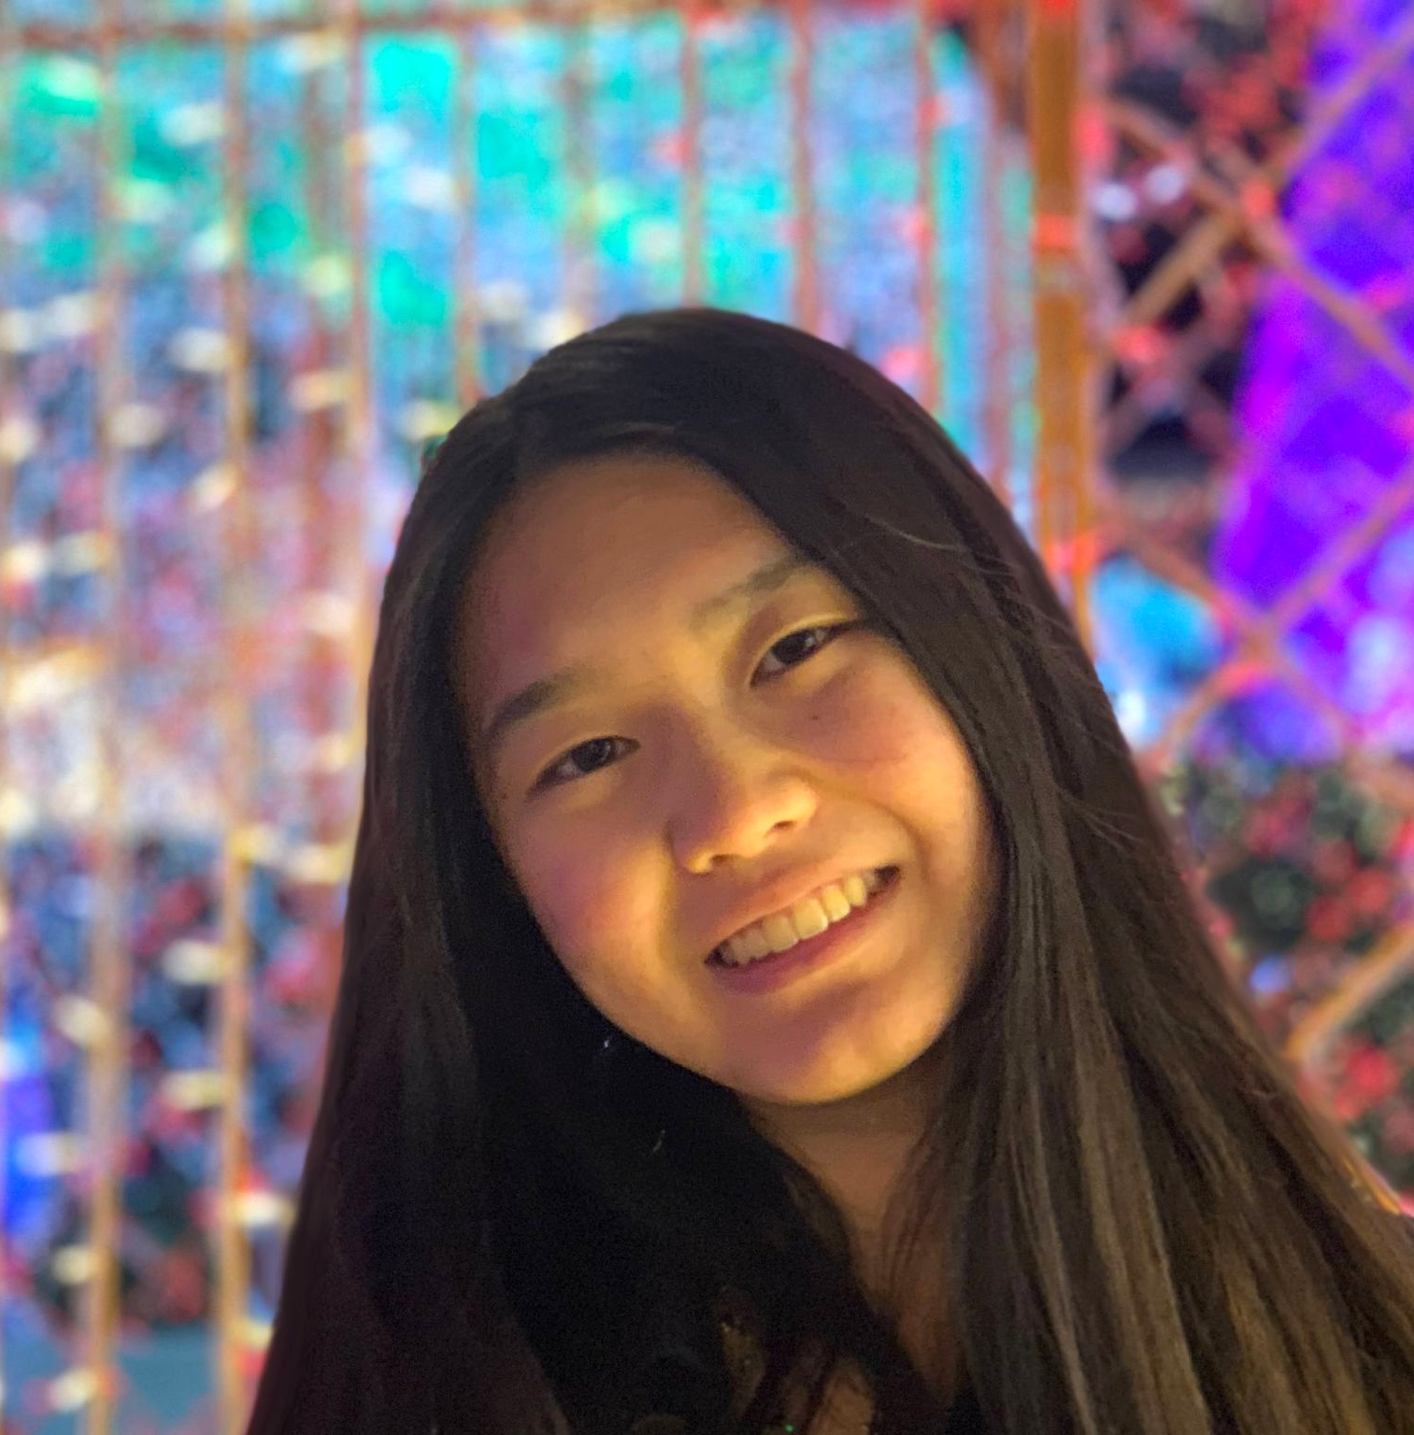
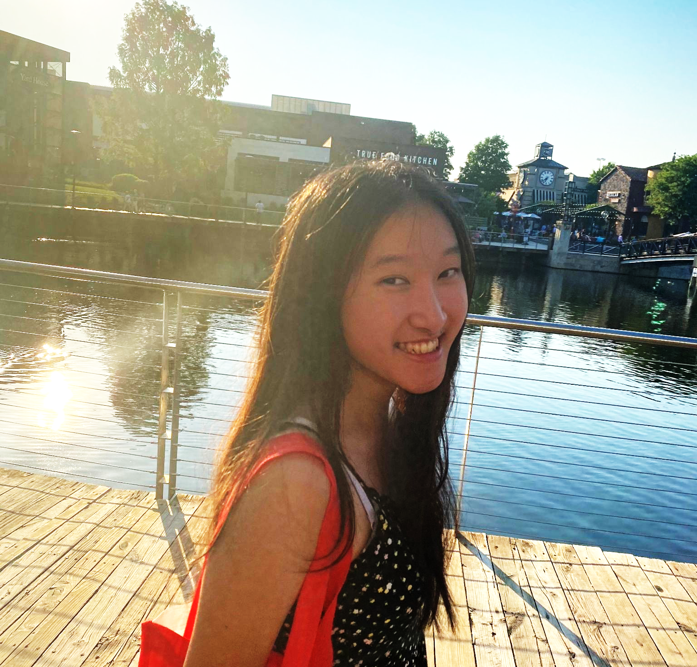

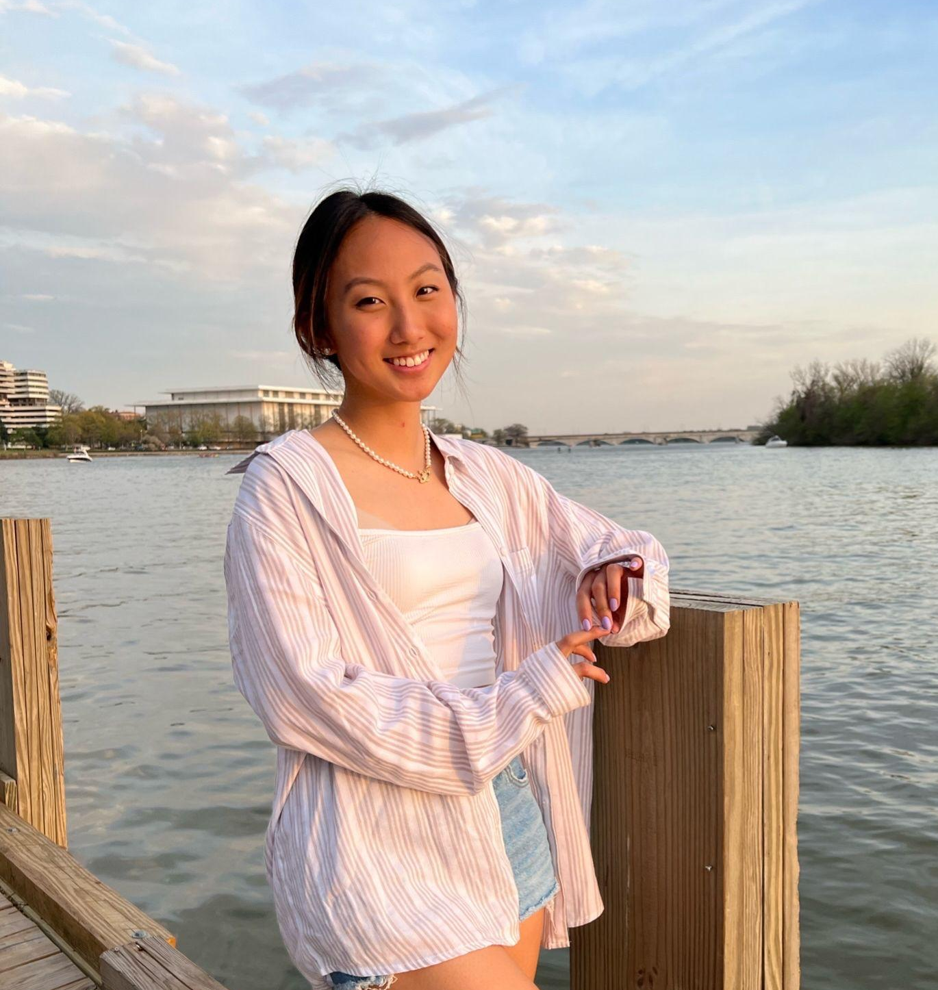


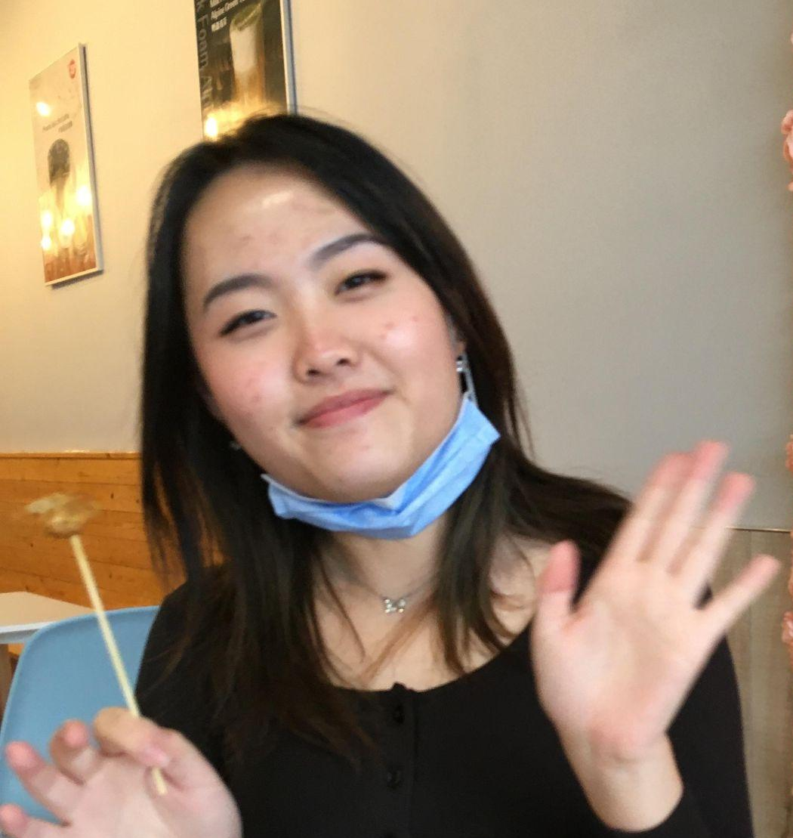
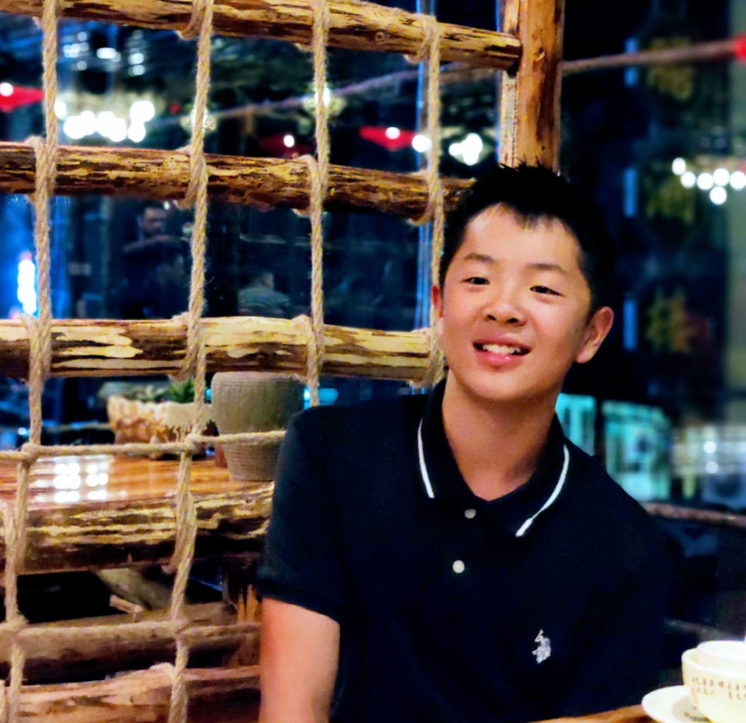
Thomas
Suwen
Allison
Kieu
Injoo
Jesse
Kelly

Slide 4
What is Project Bridge?
Personal experiences with mental health and rising international mental health crisis led to the creation of Project Bridge
Project Bridge includes:
  A website where teens could post about mental health stories (personal or informative)
  Resources to mental health hotlines
  Multimedia contest
Sponsored by FAPAC and CLUSA

Slide 5
Overview of Presentation
01
Introduction
02
Contest
03
Outreach & promotion
04
Website
05
Conclusion & questions

Slide 6
01.
Introduction
Around 1 in 5 teens suffer from at least one diagnosable mental health disorder
Half of US teens with mental health disorders are not treated
Power of personal stories

Slide 7
02.
Our Contest
Multimedia
Teens around the country
Cash prizes
Encourage teens to talk about mental health and share their stories
Submission form
Rubric and FAQs

Slide 8
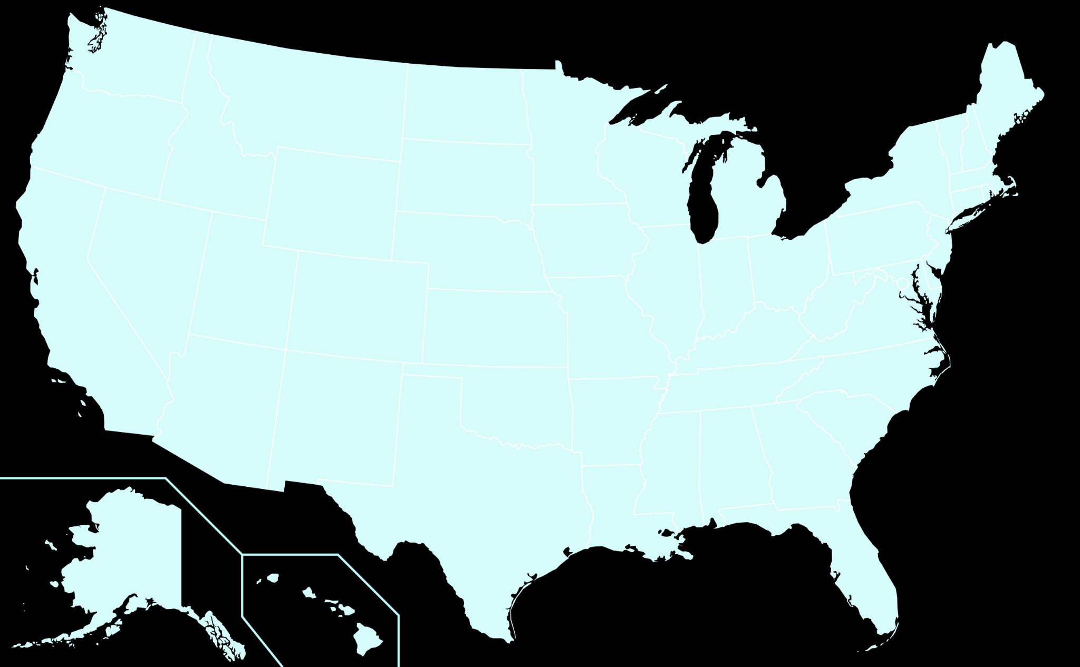
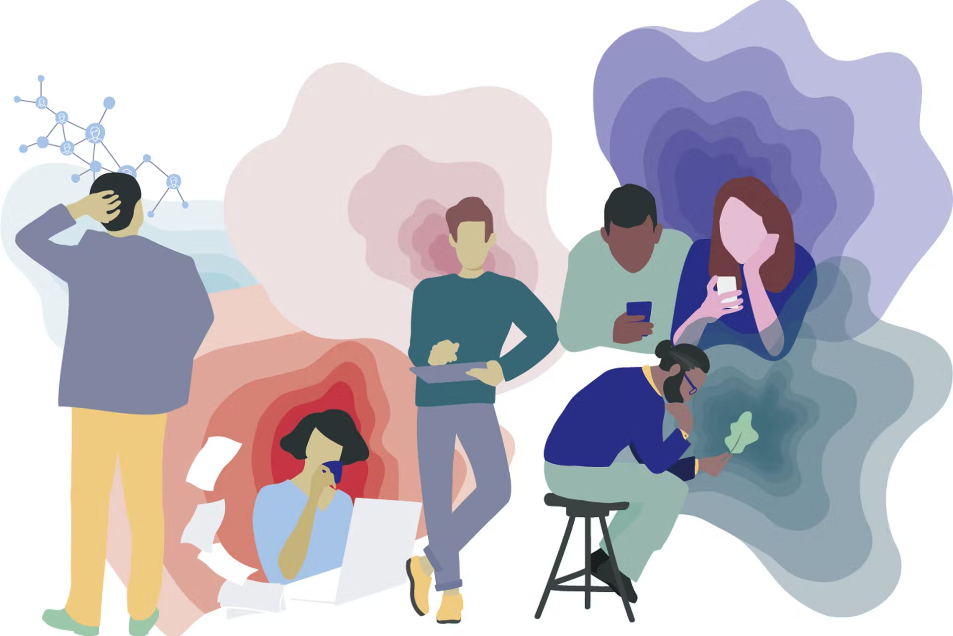
Submissions
across the US
A wide variety of topics
Including: anxiety, depression, bipolar disorder, Tourette's syndrome, childhood trauma
Maryland, Virginia, New Jersey, Florida, Nebraska, Texas, Illinois

Slide 9
03.
Outreach & Promotions
How did we promote our contest?

Slide 10
Outreach
Newsletter
Instagram Promotion
Support from FAPAC and CLUSA

Slide 11
Social Media
Posts and stories
Instagram promotions ($25/day)
19,428 people reached
386 ad taps and 484 website taps

Slide 12
04.
Our
Website

Slide 13
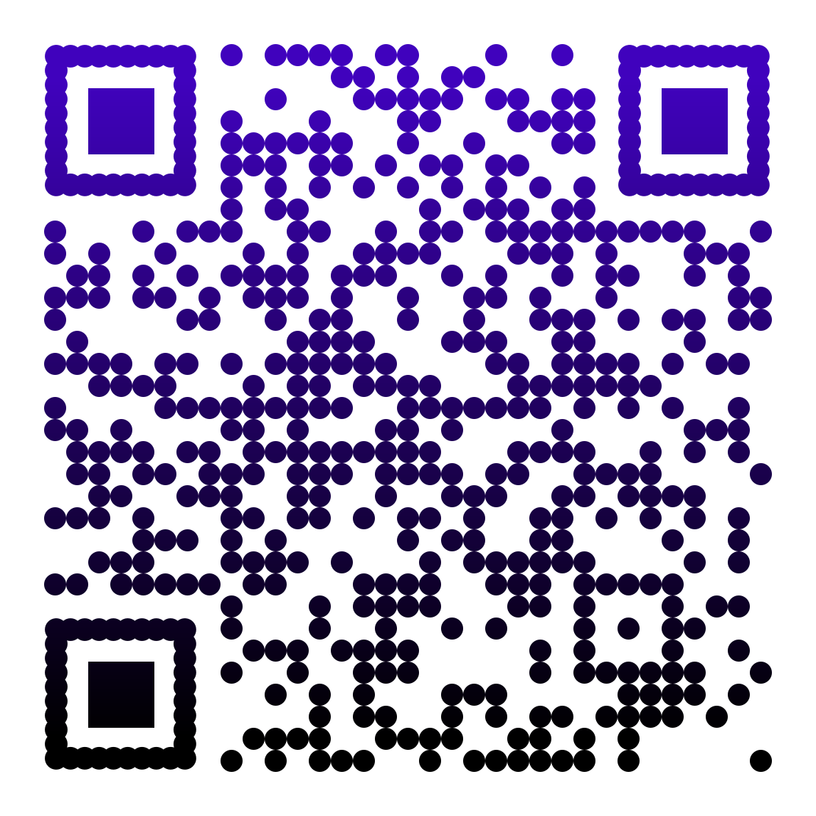
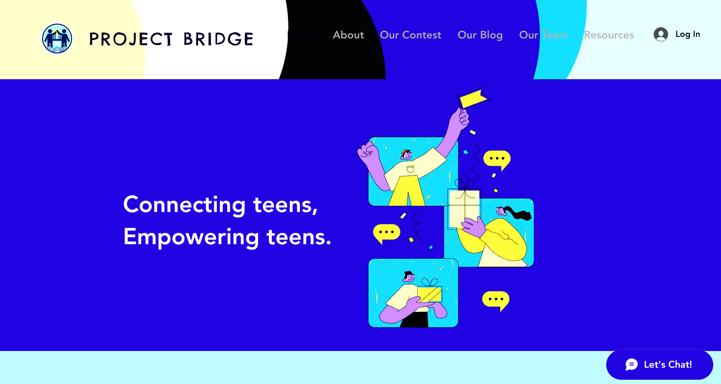
Here's our
website:

Slide 14
Our Website in a Nutshell
Home Page
Resources
Contest Page
Our Blog
About
Our Team

Slide 15
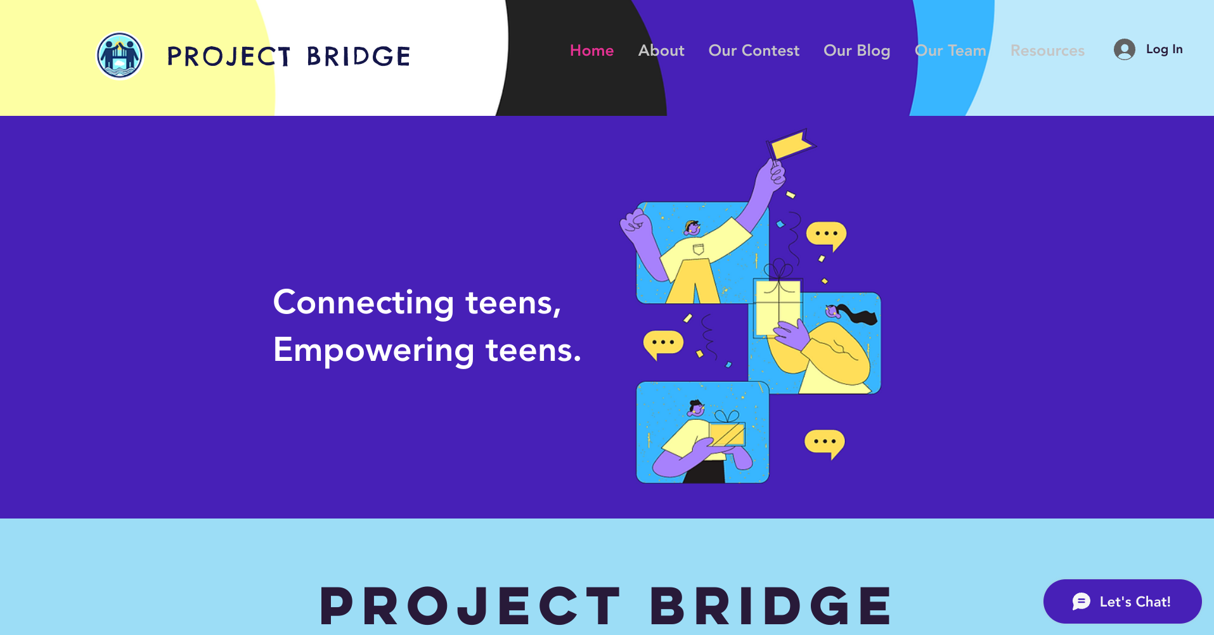
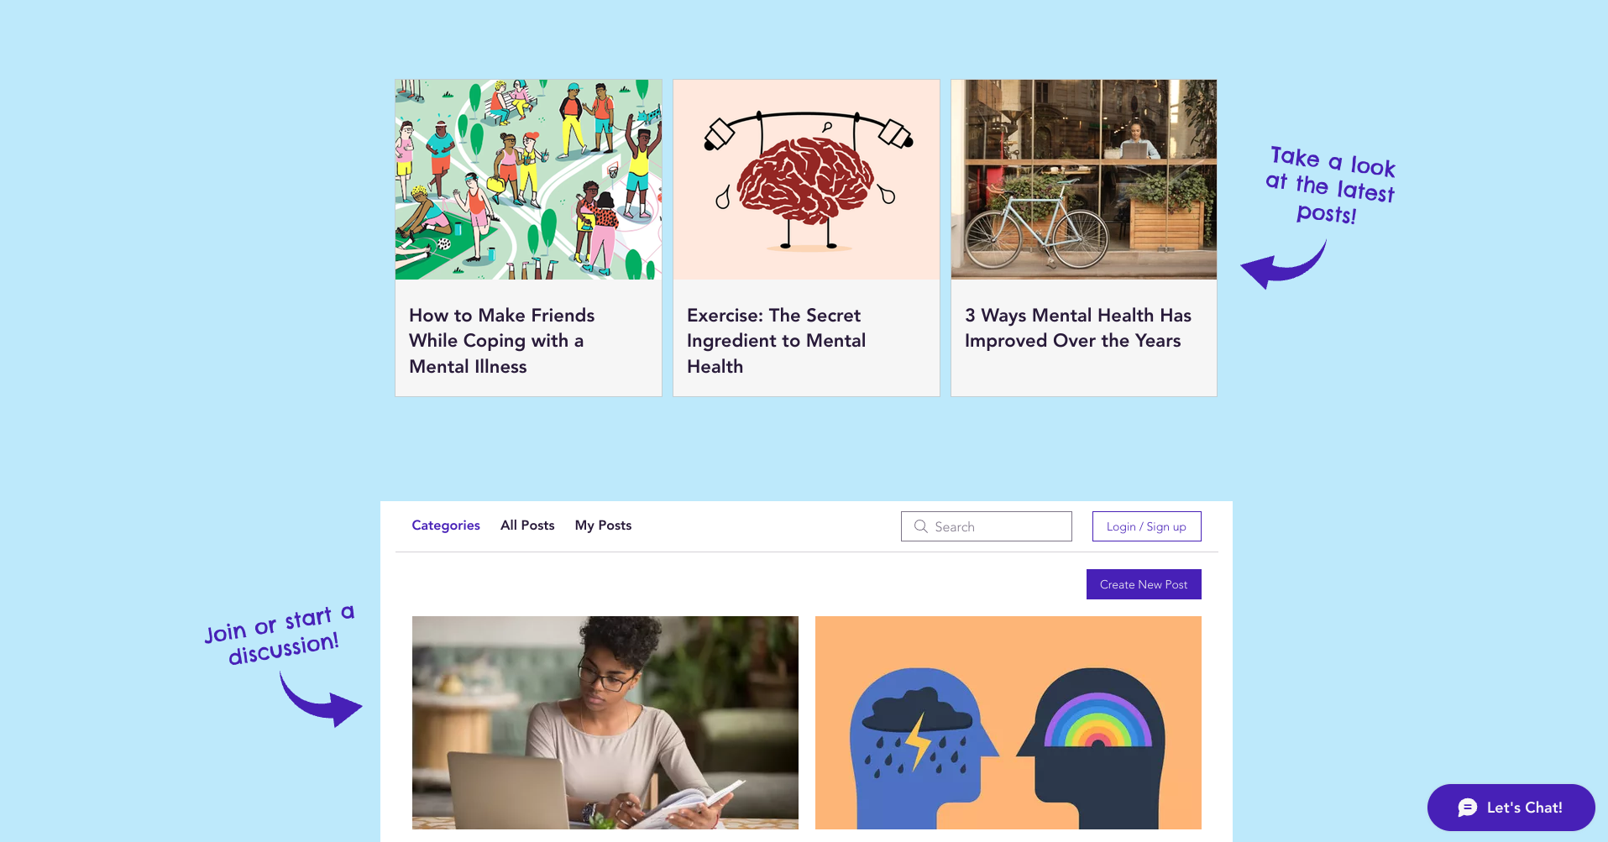
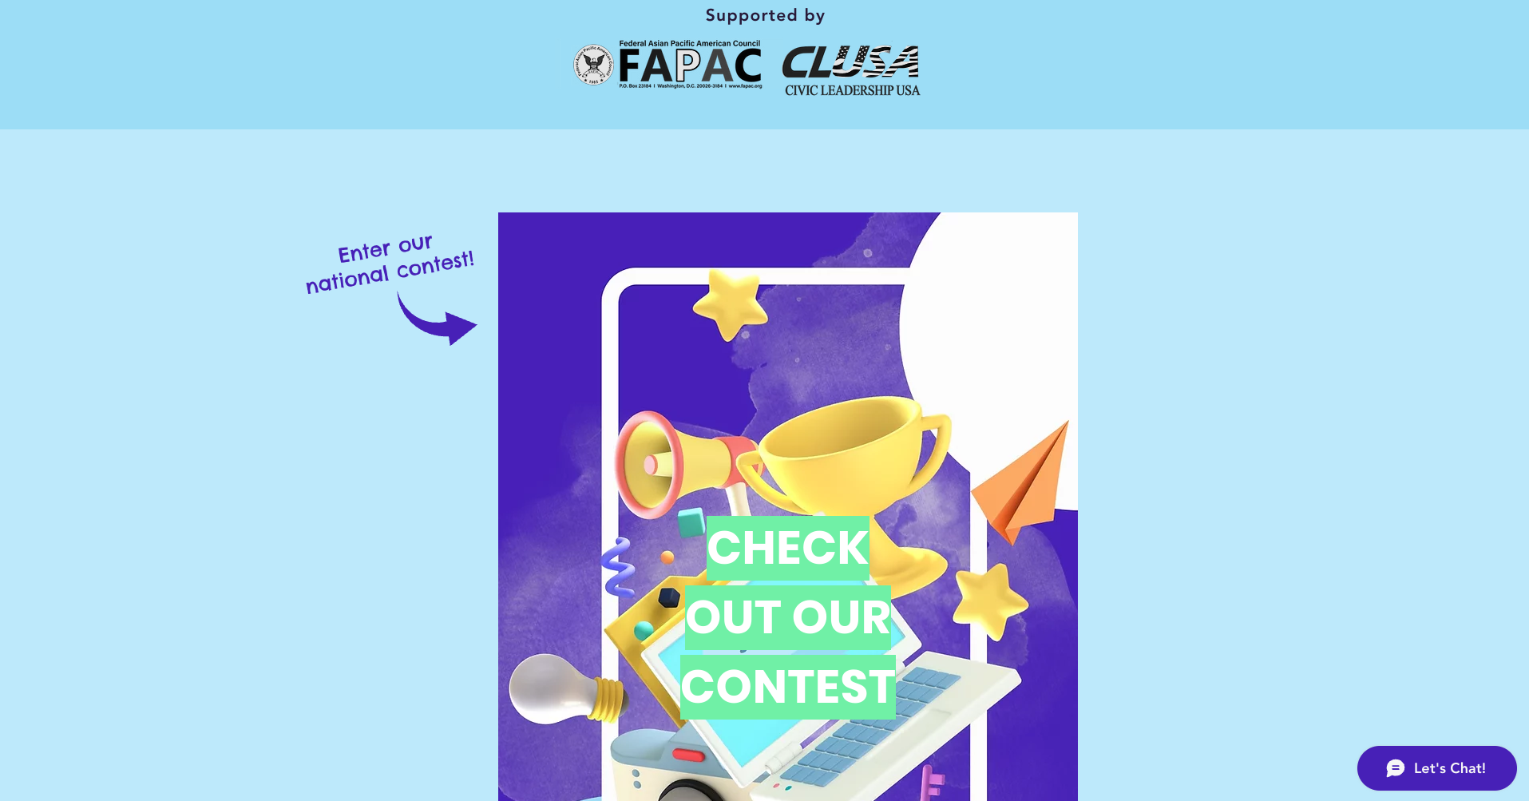
Home page

Slide 16
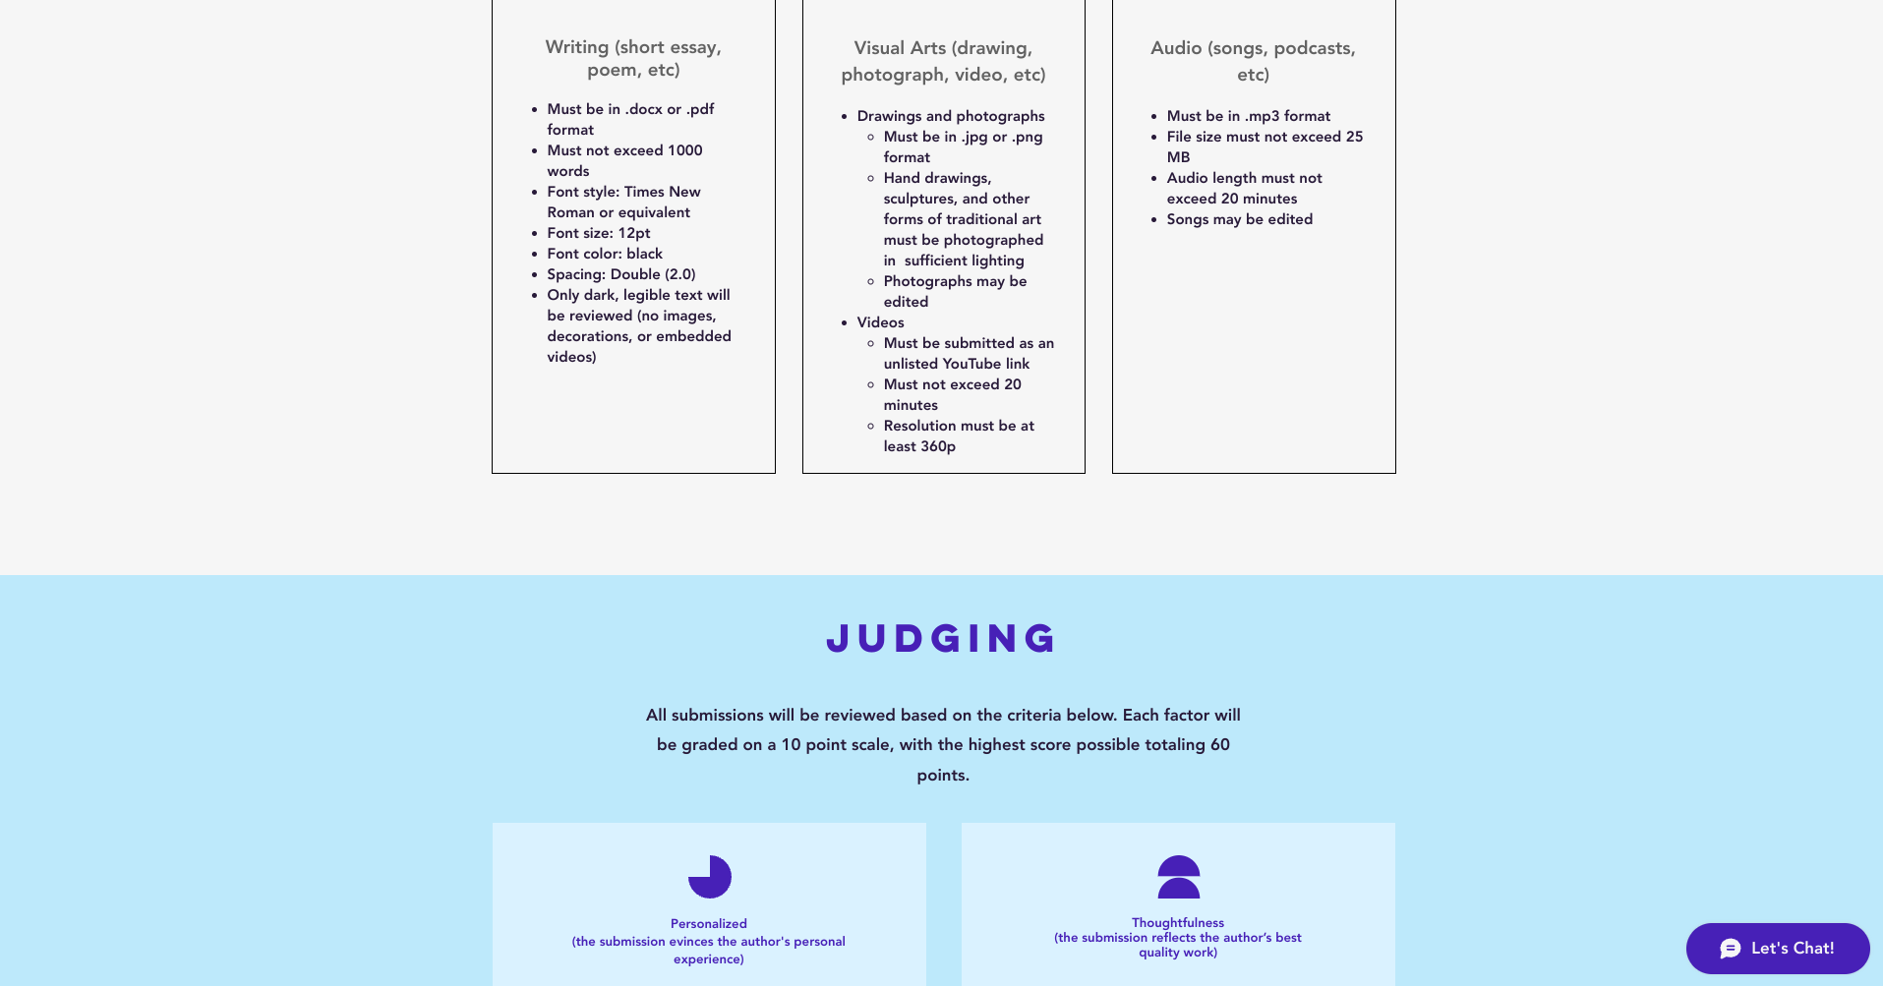
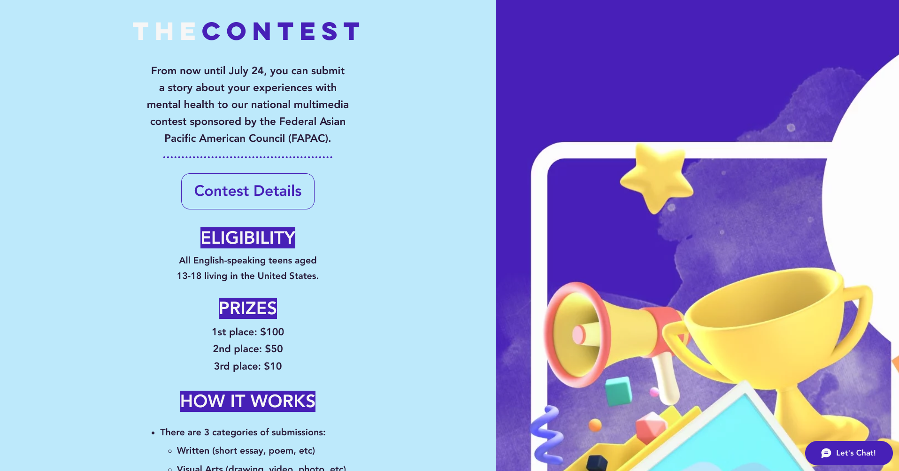
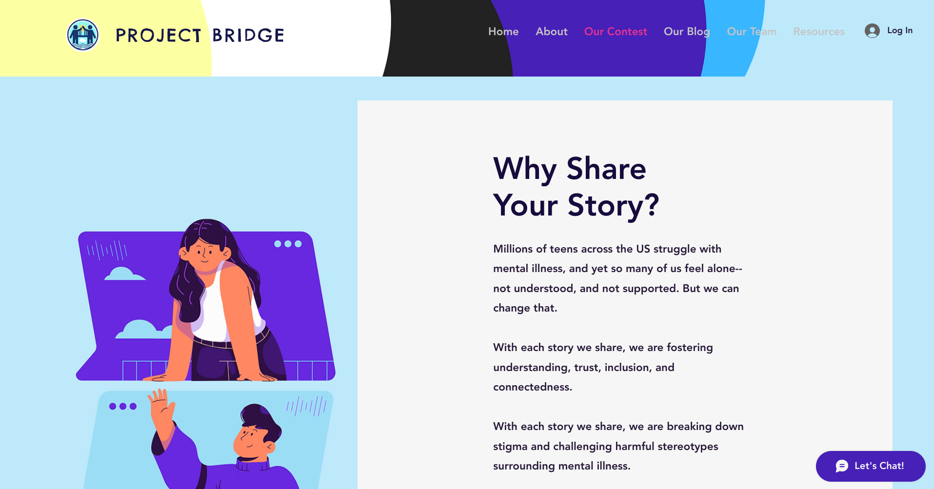
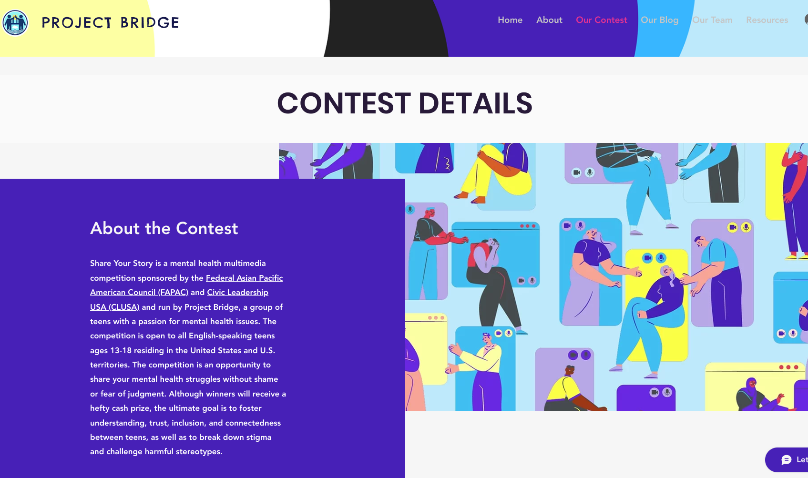
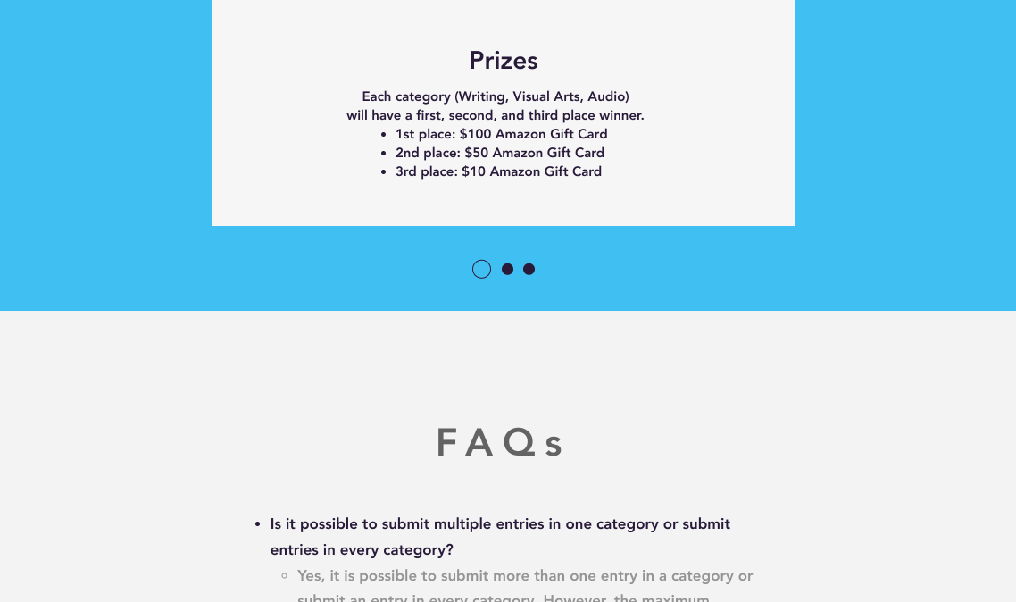
Contest Page
Details
Main page
Detailed judging info, rules, FAQs, etc about contest
Contest purpose, general information, submission link

Slide 17
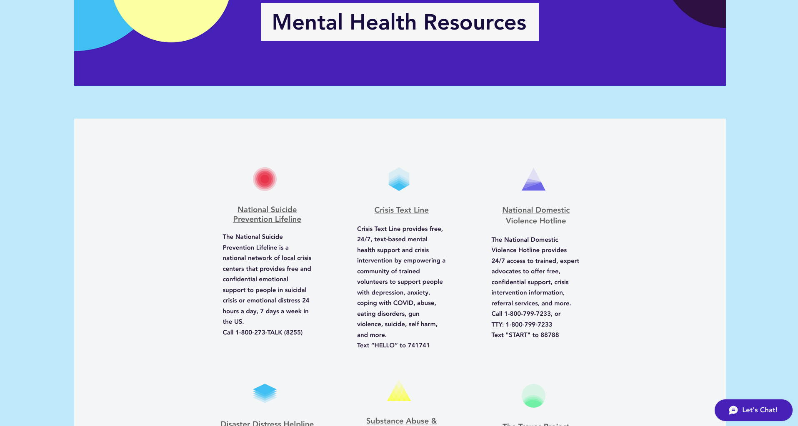

Slide 18
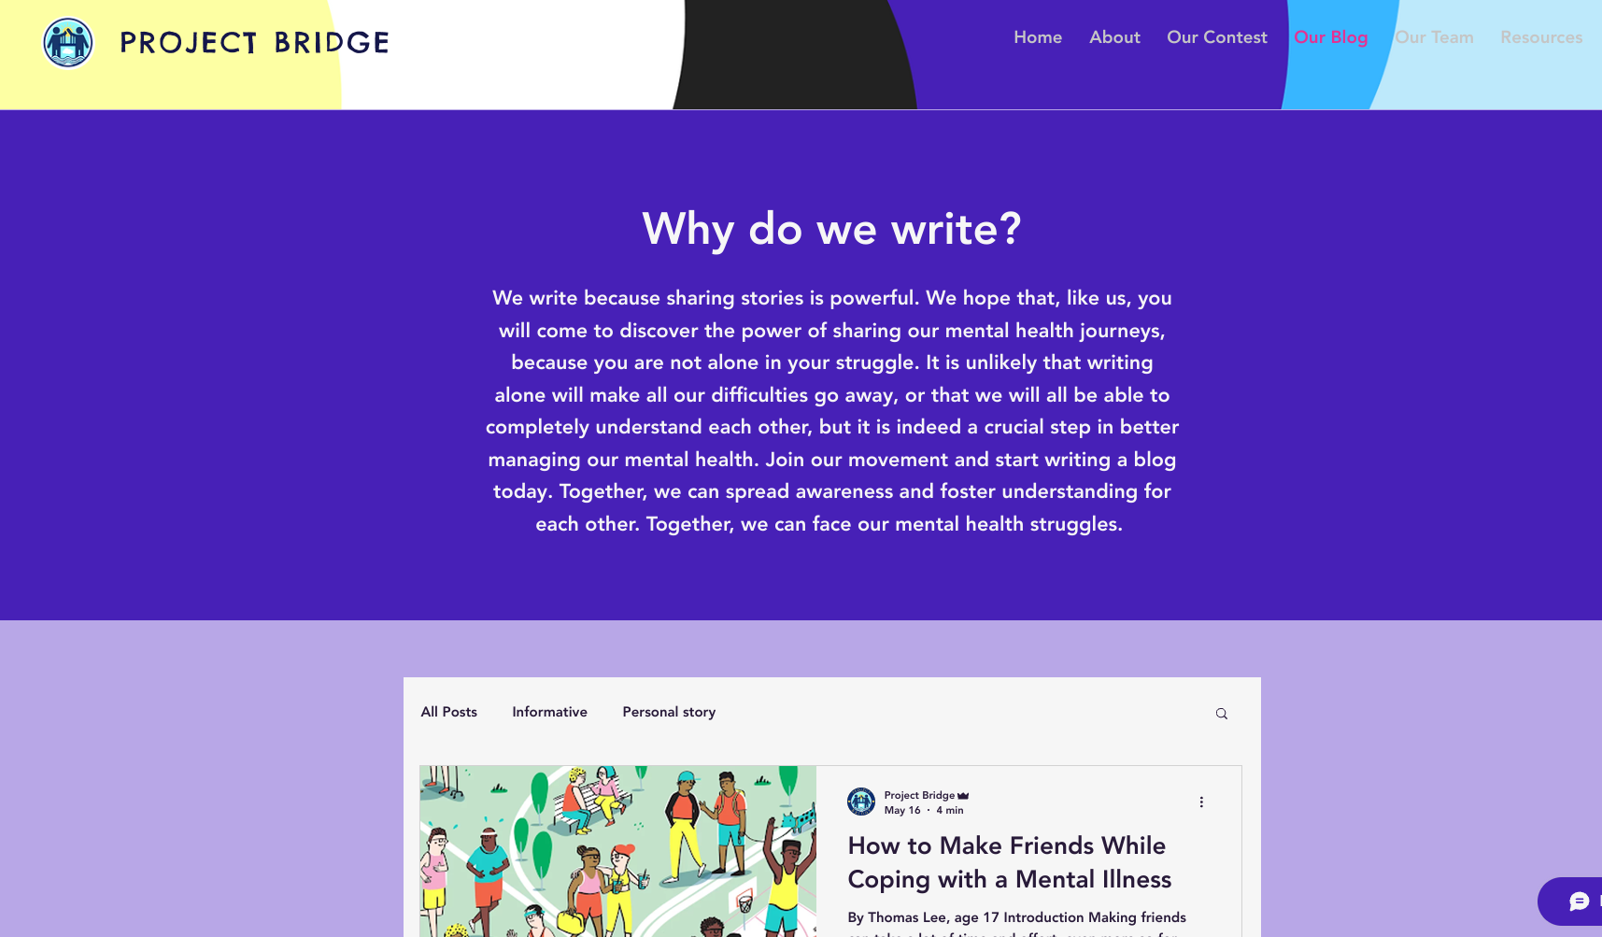

Slide 19
05.
Conclusion & Reflections

Slide 20
Future Plans
Review submissions and distribute prizes
Create a new page for submissions on our website
Display all submissions with consent

Slide 21
Conclusions & Reflections
CHALLENGES
SUCCESSES
TAKEAWAYS
Persisting through pandemic
Launched website and contest
Reaching thousands of people
Getting started
Working together virtually
Staying motivated and dedicated
Meet in-person (ideally)
Communicate regularly
Passion → Hard work

Slide 22
Special thanks to our individual and
team mentors, as well as all of the adults in the Future Star Program for organizing this program and for providing us
with support, guidance, and
encouragement!

Slide 23
Questions?

Slide 24
Thank you!
We hope you enjoyed our presentation!

Slide 25
References
https://adolescentwellnessacademy.com/teen-mental-health-facts-statistics/#:~:text=An%20Introduction%20to%20Teen%20Mental%20Health&text=Recent%20studies%20indicate%20that%20approximately,health%20crisis%20continues%20to%20grow.
https://jamanetwork.com/journals/jamapediatrics/fullarticle/2724377?guestAccessKey=f689aa19-31f1-481d-878a-6bf83844536a

Slide 26


